Slide 1

IPMC SCHOOL OF TECHNOLOGY, CIRCLE BRANCH
Department of Software Engineering
Program of study : Diploma in Software Engineering
Project Work:
ECOCYCLE: A WEB BASED PLATFORM FOR ECO-FRIENDLY WASTE MANAGEMENT AND WATER SOLUTIONS
By
TAKYI PRINCE KOBINA
Period : SWE 2024 March – 2025

Slide 2

TAKYI PRINCE KOBINA
Quenching Thirst, Preserving Tomorrow
Providing sustainable water supply and waste management solutions to safeguard the environment and promote a healthier future.

Slide 3
PROJECT OUTLINE
Introduction.
Statement of Problem.
Research Aims and Objectives.
Limitation of project.
Project Methodology.
Conclusion.

Slide 4
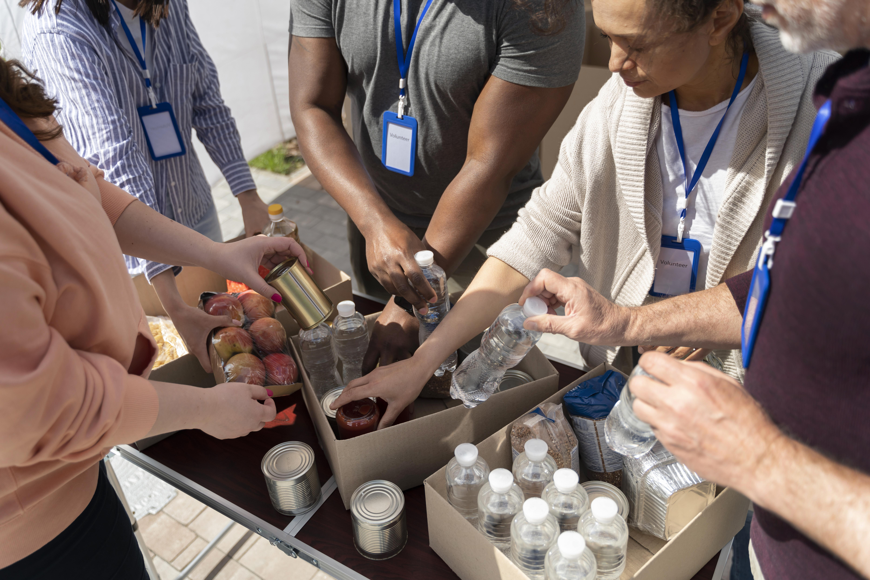
The Ecocycle website is designed to provide a comprehensive platform for promoting sustainable living and reducing environmental impact. Our mission is to deliver innovative eco-friendly solutions that cater to the diverse needs of our clients.
The website will serve as a central hub for showcasing our services including;
Potable water supply
Water delivery
Water treatment solutions
Residential waste collection
Commercial waste collection
Industrial waste collection
Dumpster rentals
Consultation on water and waste management tips
General education and many more
INTRODUCTION

Slide 5
Problems like:
Lack of access to clean water.
Inadequate waste management.
Environmental pollution.
Slums in rural and urban centers.
Health risk associated with poor management and many more.
The current lack of awareness and accessibility to eco-friendly solutions has led to increased environmental degradation and waste management issues. Our target audience faces challenges in finding reliable and sustainable services that meet their needs.
The Ecocycle website aims to address these problems by providing a user-friendly platform for accessing our services and promoting sustainable practices.
PROBLEMS STATEMENT

Slide 6
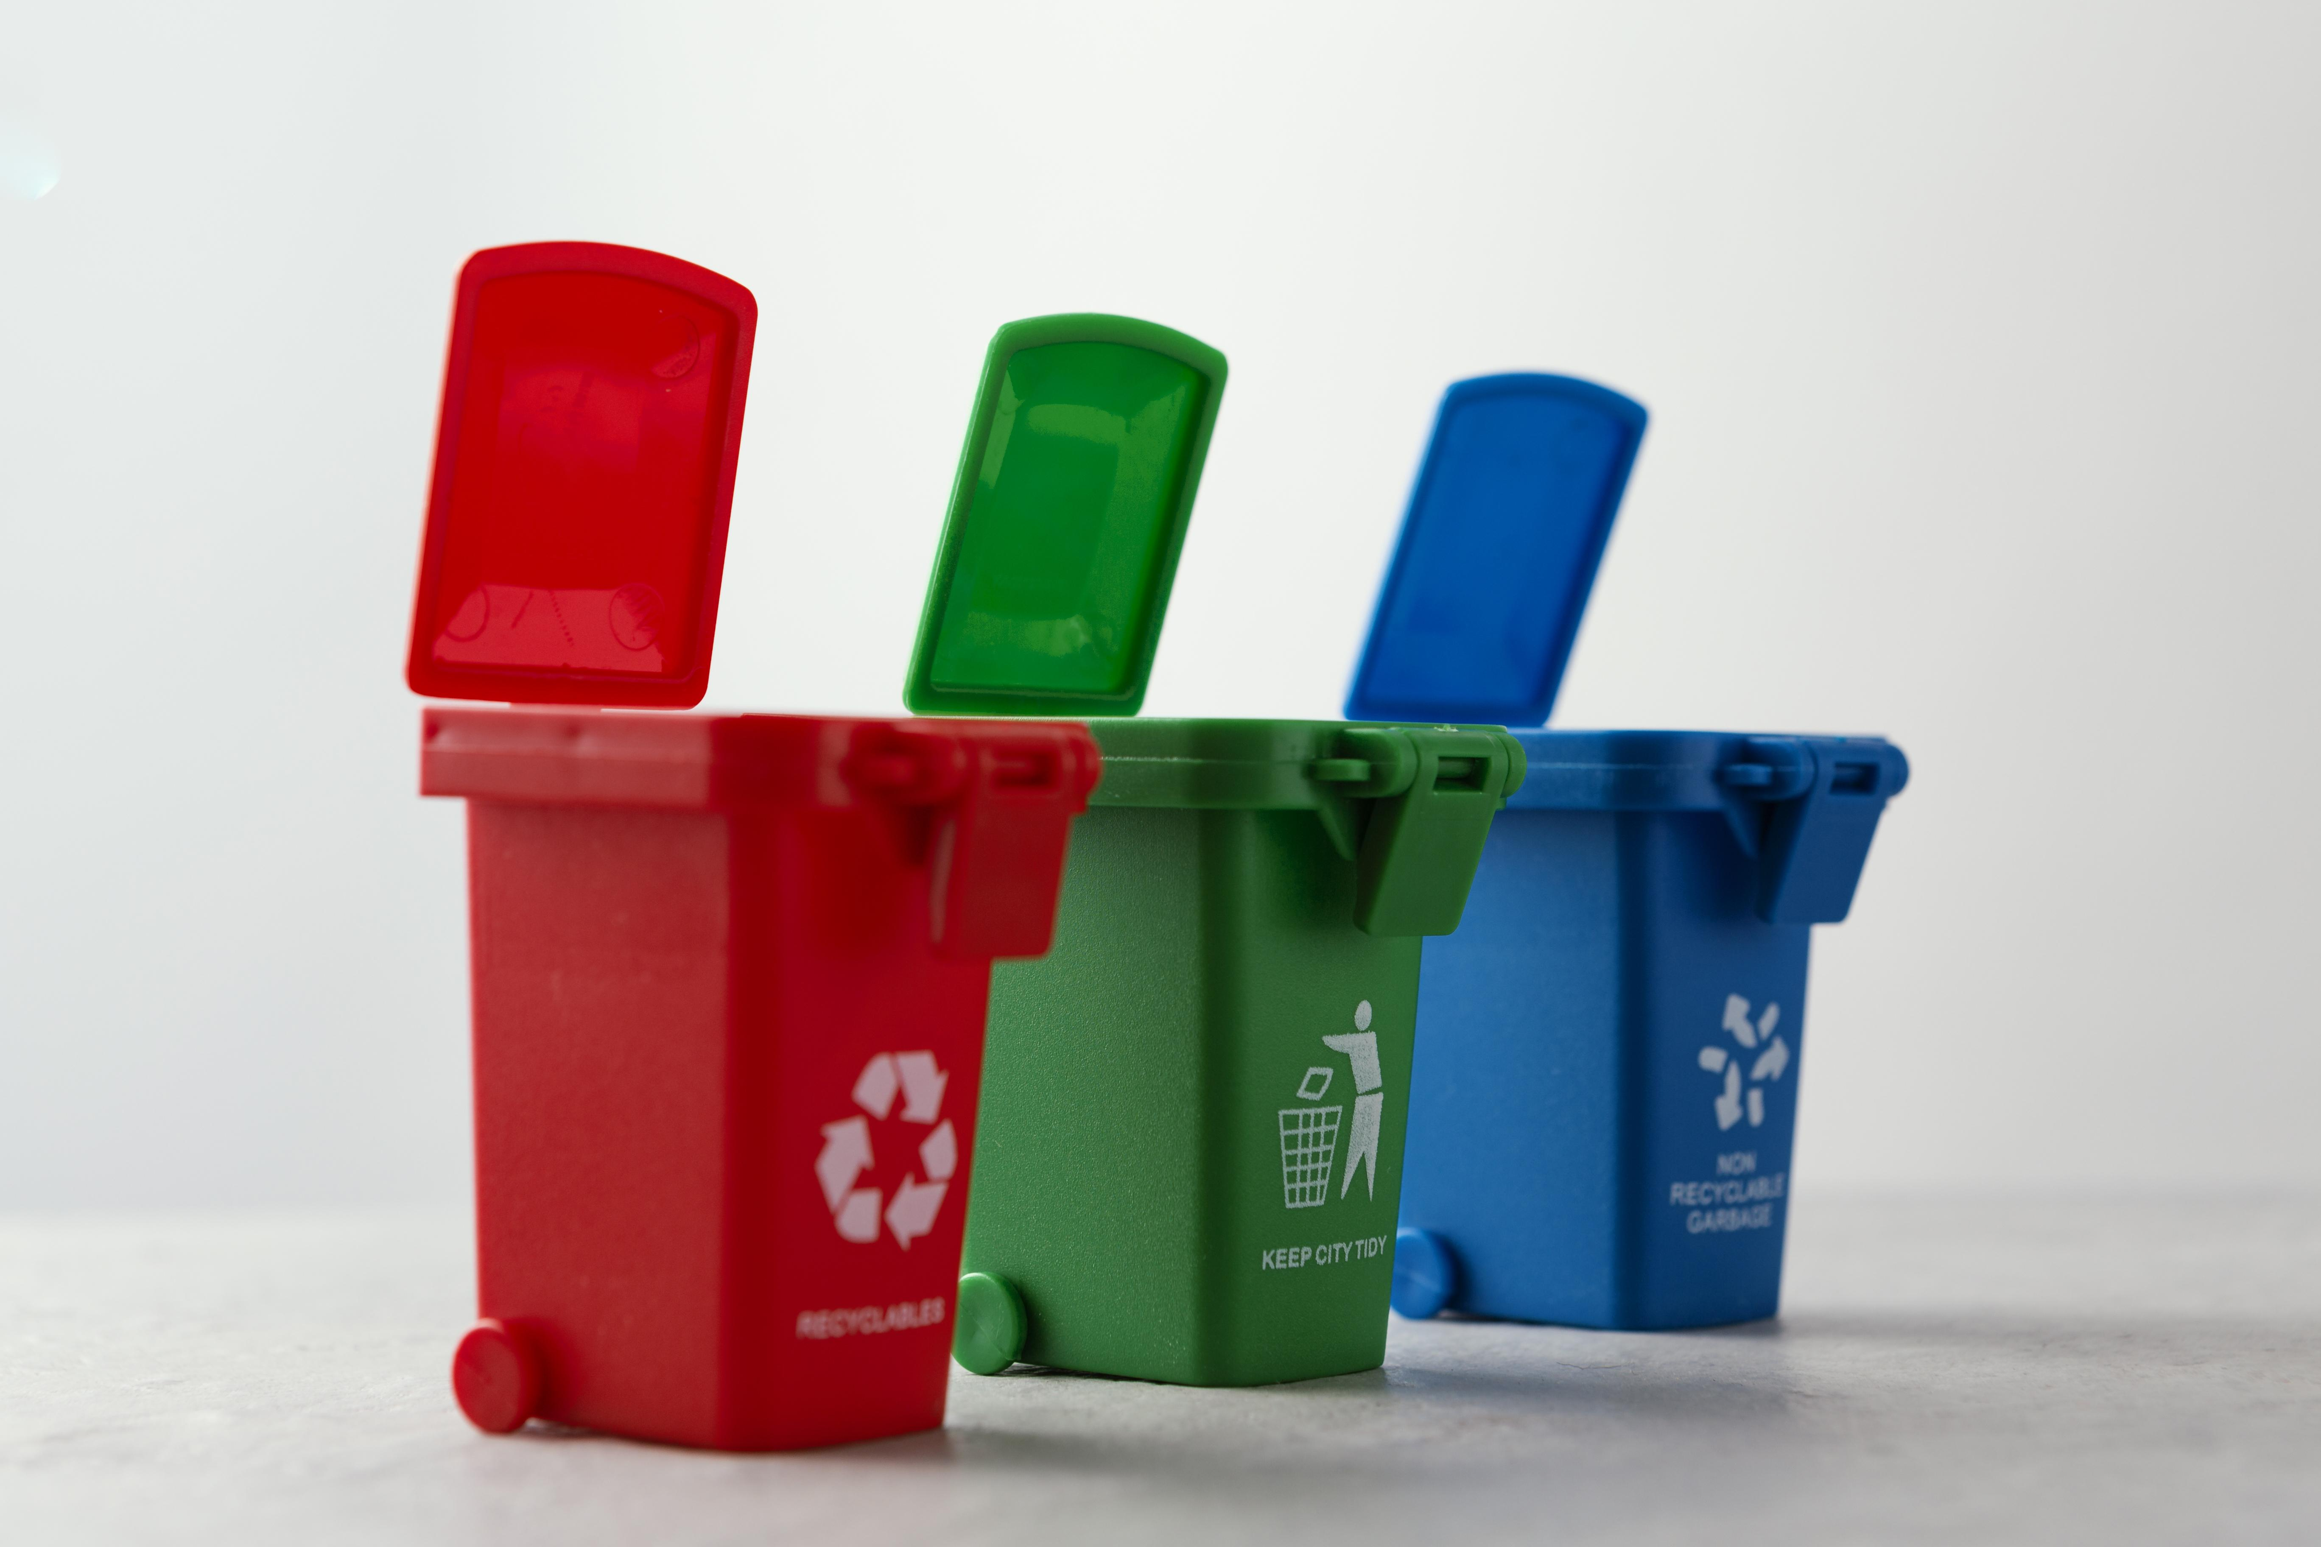
RESEACH AIMS AND OBJECTIVES
To create a website that helps to:
To create a user-friendly and informative platform that that showcase our eco-friendly services and promotes sustainable living.
To increase awareness and accessibility to our services, targeting residential, commercial and industrial clients.
To provide a comprehensive resources for clients seeking eco-friendly solutions and sustainable practices.
To establish Ecocycle as a leading provider of eco-friendly services and promote clean environment leading to a healthy living .

Slide 7

LIMITATION OF PROJECT
The limitation of the Ecocycle website design project include:
Technical constraints , such as a website development and maintenance cost.
Time constraints, including the deadline of completion and lunch of website.
Resource constraints, such as the availability of personnel and expertise.
Competition from existing waste management and eco-friendly service provider.

Slide 8
Phase 1: Requirement Gathering and Analysis
Conduct surveys and interview with rural residents, local businesses and households to understand their needs and challenges on the environment.
Analyze the data to identify patterns, trends, and insights that can inform the development of the Ecocycle website.
Phase 2: System Design and Planning.
Website is designed to provide a scalable, secure, and user-friendly platform Plan the user interface.
A responsive and interactive user interface built using HTML5, CSS3, providing an engaging user experience and scalable server-side application built using a programming language such as PHP for handling business logic, database interactions.
PROJECT
METHODOLOGY

Slide 9
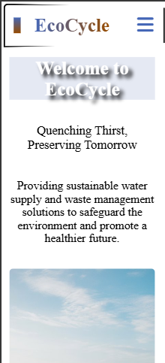
Phase 3: Development
A responsive design that adapts to different screen sizes and devices, ensuring a seamless user experience.
A system that provides insights into user behavior, service usage, and business performance.
A user-friendly interface that allows users to select services and schedule appointments.
- Optimization of the website for search engines to improve visibility and ranking to Increased visibility, improved brand awareness, and increased website traffic.

Slide 10
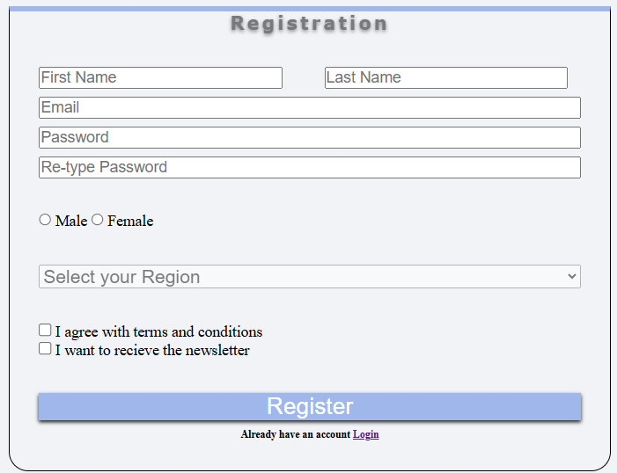
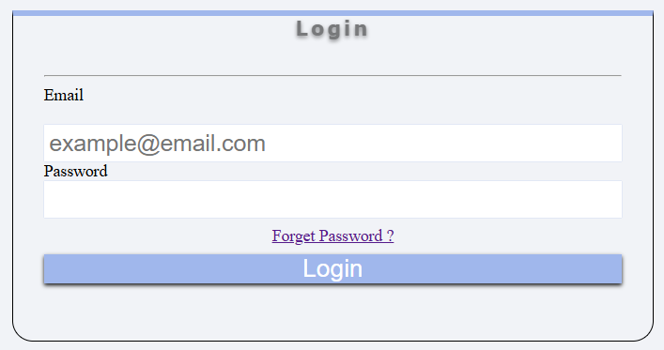
User Registration and Login
A secure user registration system that allows users to create an account and get access exclusive features.
A secure and a simple login system that allows users to manage their accounts and access exclusive features as well.

Slide 11
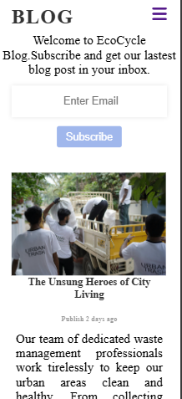
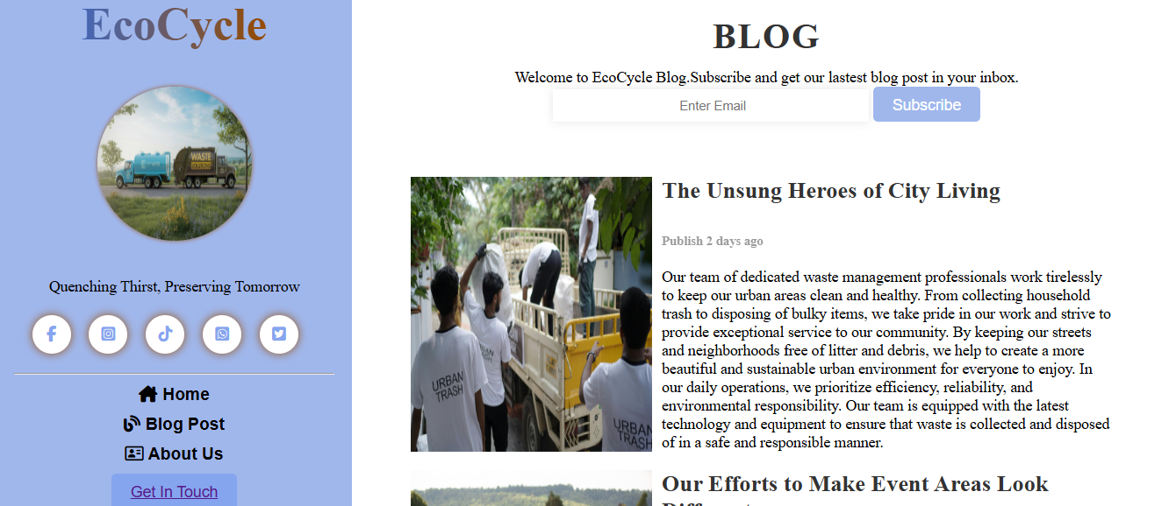
News and Update
Stay Up-to-Date with Ecocycle;
Share news, updates, and announcements about Ecocycle, including new features, services, and partnerships

Slide 12
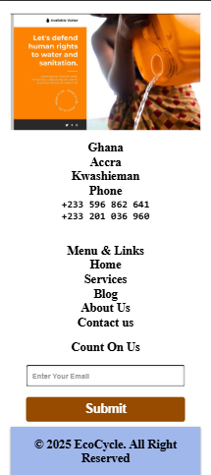
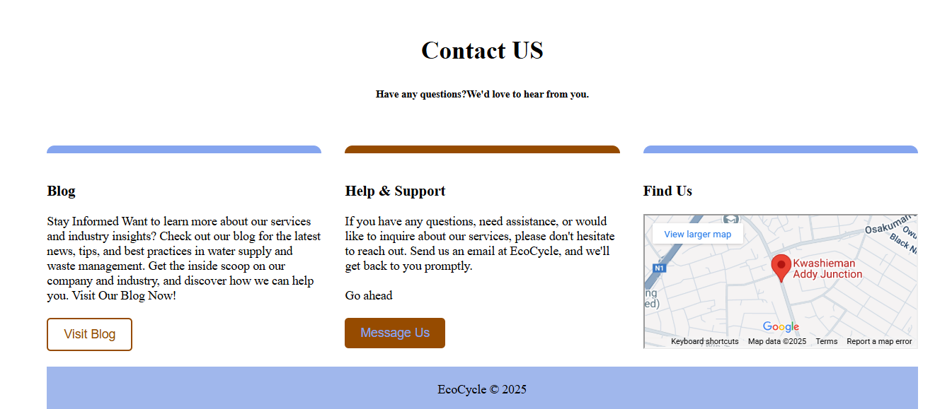
How to reach us
A simple and intuitive contact form that allows users to send messages to the Ecocycle team to a mail.
Display the company's contact information to allow users to get in touch through different channels.
And also comes with a map merged that could take clients to the exact place of company reside.

Slide 13
Phase 6: Use case diagram
Develop the USSD application in iterations, testing each functionality step by step.
Integrate the system with banking services for transactions like balance enquiries, transfers and withdrawals and bill payments.
Implement security protocols such as password for logging in and PIN authentication and encryption.

Slide 14
Phase 6: Maintenance and continuous improvement
Develop the USSD application in iterations, testing each functionality step by step.
Integrate the system with banking services for transactions like balance enquiries, transfers and withdrawals and bill payments.
Implement security protocols such as password for logging in and PIN authentication and encryption.

Slide 15
The Ecocyle website is designed to provide a comprehensive platform for promoting sustainable living and reducing environmental impact. Our mission is to deliver innovative eco-friendly solutions that cater to the diverse needs of our clients.
The website will serve as a central hub for showcasing our services including;
1.Potable water supply
2.Water delivery
3.Water treatment solutions
4.Residential waste collection
5.Commencial waste collection
6.Industrail waste collection
7.Dumpster rentals
8.Consultation on water and waste management tips
9.General education and many more
CONCLUSION

